Slide 1

E-Commerce Site
Automated Testing
nFocus
PRESENTED BY
Dharmanshi Sangani

Slide 2

Project Outline
The test will login to an e-commerce site as a registered user, purchase an item of clothing, apply a discount code.
Check that the total is correct after the discount & shipping is applied.
Apply Coupon for 15% off
The test will login to an e-commerce site as a registered user, purchase an item of clothing and go through checkout.
It will capture the order number and check the order is also present in the ‘My Orders’ section of the site.
Order is submitted successfully

Slide 3
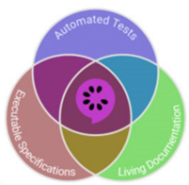
C# Selenium
Create robust and maintainable automated tests
TOOLS AND FRAMEWORKS
Specflow
Behaviour- driven Development
Visual Studio
Development Environment and Debugging
Allure Reporting
Comprehensive test reporting and analysis

Slide 4

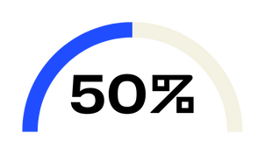
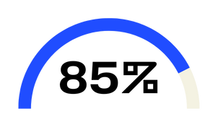

Implementation
Feature File
Gherkin file
Step Definitions
Steps class, Scenario Context, Assertions
Optimisation & Efficiency
Applying POM structure, adding utilities methods, Web Driver Wrapper
Reporting
Allure Reporting

Slide 5
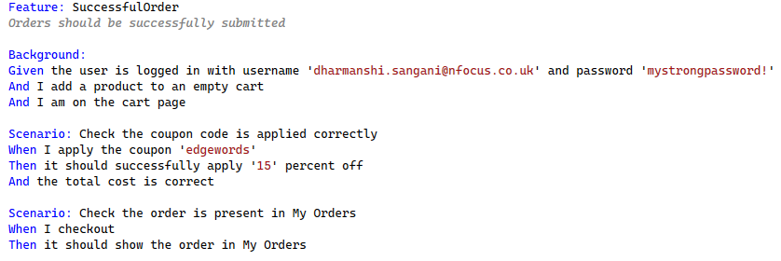

Feature Definition: Describes the feature under test, providing a high-level overview.
Scenarios: Individual test cases that describe specific situations or behaviours.
Steps: Actions and expected outcomes, written in plain language using keywords like Given, When, Then, And.
Background: Sets up common preconditions for all scenarios in the feature.
Gherkin File

Slide 6

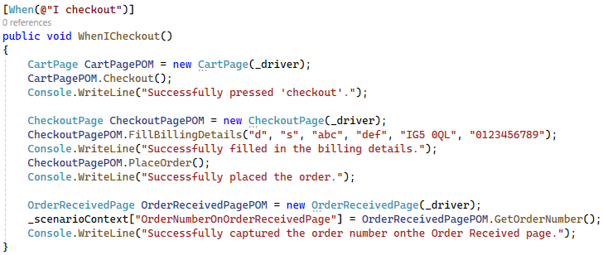
Step
Definitions
One Method per Step:
Clarity and Maintainability: Each step in the Gherkin file should correspond to a single method in the step definition file
This ensures clarity and makes the code easier to maintain.
Scenario Context:
Used to share data between steps within the same scenario.
This is useful for maintaining state and passing variables.
Assertions:
Used to verify that the application behaves as expected.
They are typically placed in Then steps.

Slide 7
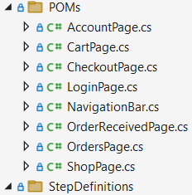
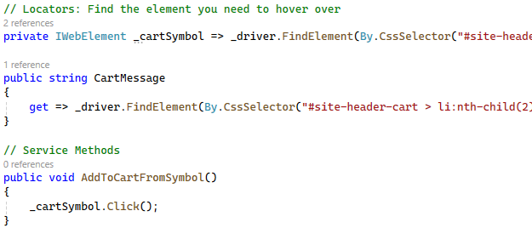
Design Pattern: Page Object Model (POM)
01
The constructor initialises the WebDriver instance for the page object, ensuring that the same WebDriver instance is used across different methods within the page class.
02
Locators are used to find elements on that specific web page. They should be defined as private fields or properties within the page class.
03
Service methods perform actions on the web page, such as entering text, clicking buttons, and verifying elements. These methods interact with the locators defined in the class, but not include any assertions.

Slide 8
Hooks Class
Browser options configuration
Before method setup
After method teardown
Helpers Class
Utilities
WebDriver wait implementation
Avoids using ‘Thread.Sleep’
Better alternative to implicit wait
WebDriver Wrapper Class
Type-safe WebDriver interactions
Encapsulation of WebDriver methods
Runsettings File
Set up environment variables/ parameters

Slide 9
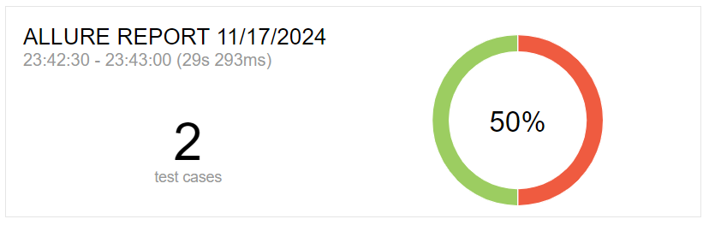
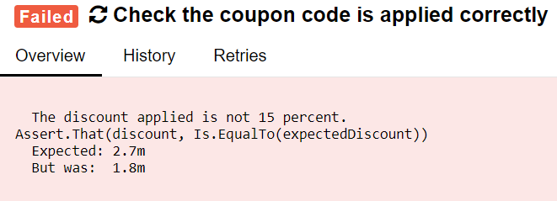
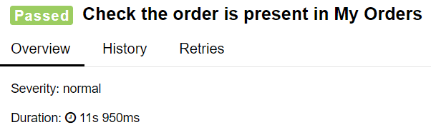
Allure Reporting
Clear and Detailed Test Reports
Integrates with various testing frameworks and CI/CD tools, offering a comprehensive view of test results, including detailed steps.
Visually Apealling
Easy-to-read reports, making it easier to understand test results.
Attachements
Supports adding screenshots, logs, and other attachments to test results for better debugging.

Slide 10
DEMO

Slide 11
THANK YOU
ANY QUESTIONS?

